Slide 1





WELCOME
To Our AI Project

Slide 2


Team members
Mahmoud Taha Mohamed Abdelaal
Nourhan Mohamed Fawzy Mohamed
Maryam Hosam Eldien Moustafa Ahmed
Alaa Mohamed Ahmed Yousif

Slide 3
﻿Table Of Contents
1
Problem
2
Solution
3
Dijkstra’s Algorithm
4
A* Algorithm
5
Maze

Slide 4
Problem
Where you need to find paths, and reach a particular destination
these problems are called Maze Problems. In maze problems, you generally have given the approaches to go with, so maze considerd a searching problem

Slide 5
Solution
By lot of searching we found that Dijkstra and A* algorithms are efficient in our
problem than other searching algorithms

Slide 6
Dijkstra algorithm
Dijkstra algorithm is one of the most simplest approach to do that.
Dijkstra’s Algorithm is one of the more popular basic graph theory algorithms.
It is used to find the shortest path between nodes on a directed graph. We start with a source node and known edge lengths between nodes.

Slide 7
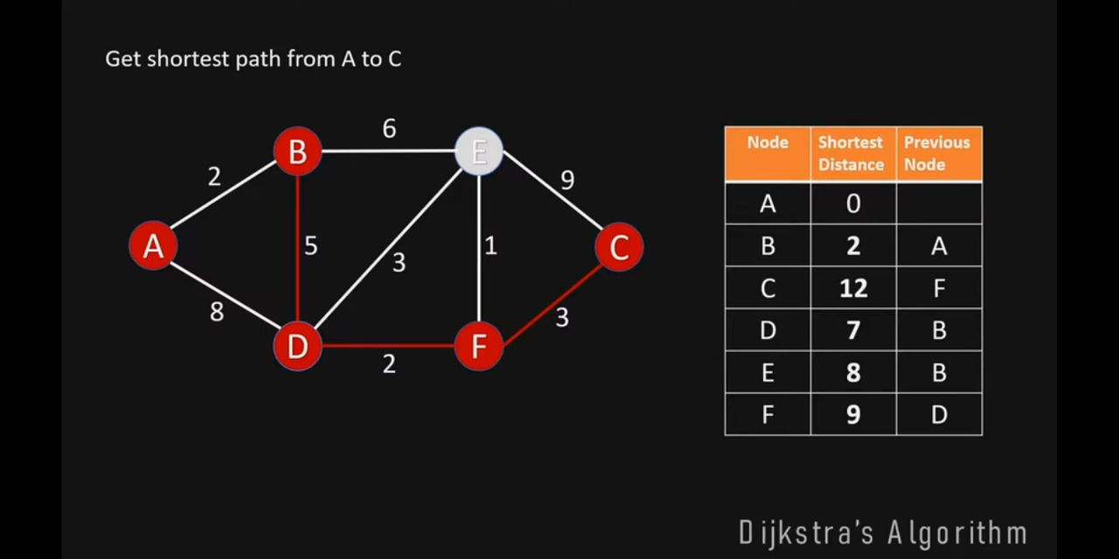
How algorithm works
It picks the unvisited vertex with the lowest distance, calculates the distance
through it to each unvisited neighbor, and updates the neighbor's distance if
smaller. Mark visited when done with neighbor

Slide 8
Dijkstra’s Algorithm
IMPLEMENTAION

Slide 9
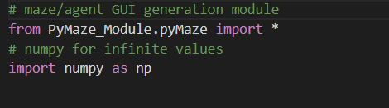
﻿
Used to import all functions , classes ,variables defined in pymaze module within the pymaze module packege

Slide 10
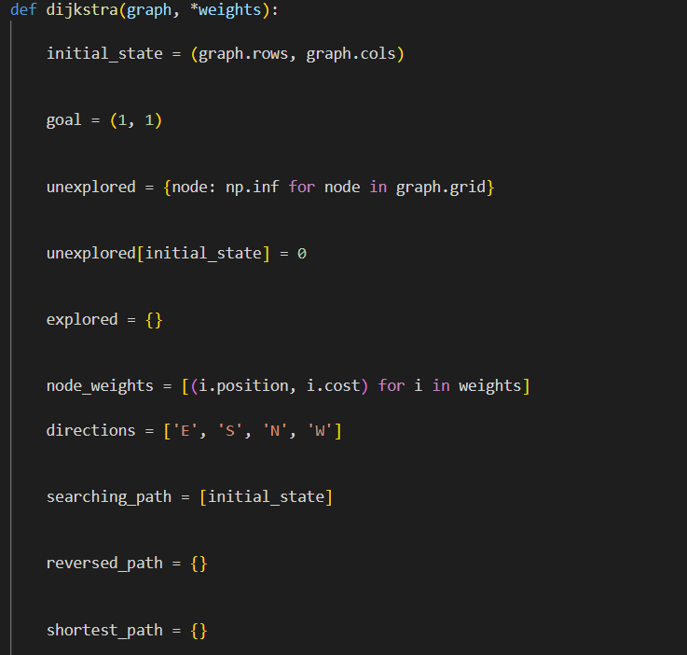
﻿
initial state { graph raw, …}:
the initial state is the max value of rows and columns where we start from.
goal (1,1):
goal is to reach to (1,1).
unexplored ={node. np…..}:
is a dictionary that has all nodes in the graph as a key and their a values infinity.
unexplored {initial stale }=0:
move to current node its cost is o.
explored = {} :
empty dictionary holds explored nodes.

Slide 11
﻿
node_weights= [(i. postion, i. cost) for i in weights]:
lists that have same sets at index 0 pos.of weighted edge index 1 is cost of weighted edge.
directions = ['E’,’S’,’N’,’W’]:
list our 4 directions
searching_path = [initial_state]:
List of paths that the agent searched to find the shortest path reversed_path = {}:
dictionary of the reversed path its from goal to
start.
shortest_path = {}:
dictionary of the reverse of reversed path.

Slide 12
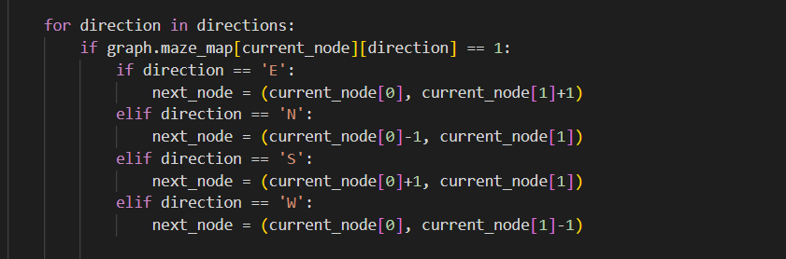
﻿
for direction in directions
If it’s available to move in to this direction.
If direction ==E: rows the same add 1 to Col
If direction ==N: rows -1 ,col the same
If direction ==S: rows +1 ,col the same
If direction ==W: rows the same subtract 1 from Col

Slide 13
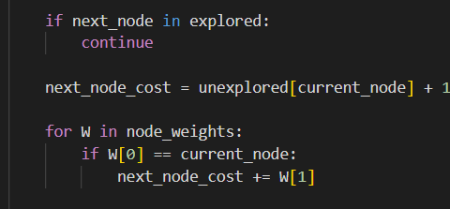
﻿
if next_node in explored:
continue node in explored don't do anything.
next_node_cost = unexplored[current_node] + 1:
add one to current node.
for w in node weights:
if position of this node = current node.

Slide 14
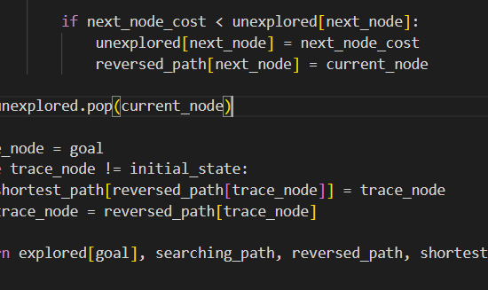
﻿
--if next_node_cost < unexplored[ next_node]:
unexplored[next_node] = next_node_cost
--reversed_path[next_node] = current_node :
Compare new cost with old cost
if its smaller we swap.
--unexplored. pop (current_node):
remove current node from unexplored .
--trace_node = goal :
node starts from goal.
The while loop stops when trace node =initial node
Shortest is the reverse of reversed path.
the function of Dijkstra returns the explored of goal, searching path, reversed path, shortest path-

Slide 15
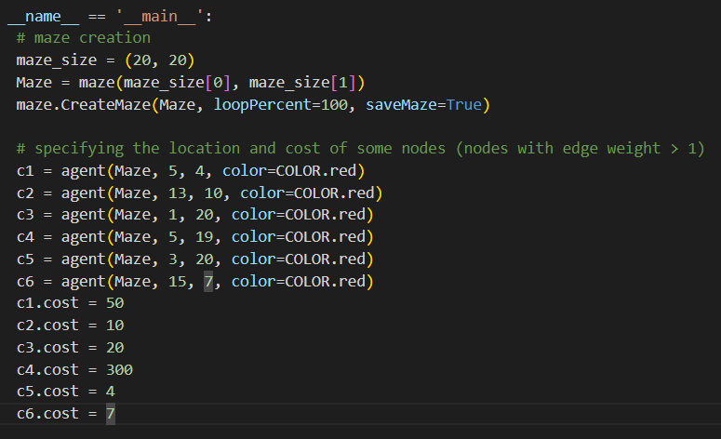
﻿
The main function
maze size is 20*20
create maze function takes maze object , loop percent is the percentage of nodes that have more than 1 path, Save maze.
costs of nodes in maze, their position and their color.

Slide 16
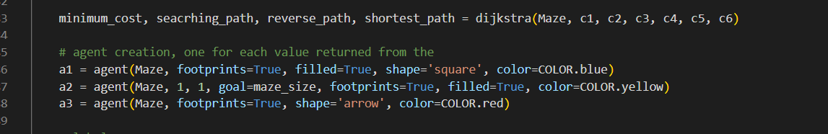
﻿
Dijkstra function takes maze obj and cost.
a1 agent represents searching path
a2 agent represents reserved path
a3 agent represents shortest path

Slide 17
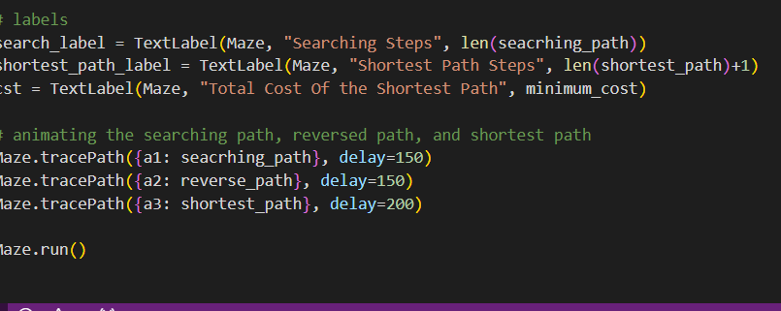
﻿
Text label for search
Text label for shortest path
Text label for min cost
animation of searching path , reversed,
shortest path

Slide 18
Summery of the Dijkstra Algorithm
Dijkstra's algorithm is guaranteed to find the shortest path but may become inefficient for large graphs.
In dynamic environments, where the graph changes frequently, alternative algorithms like A* may be preferred.

Slide 19
﻿A* algorithm
why we choose implementation with a* algorithm
we interested in a* algorithm because of the efficiency of it , it searches very few cells to find the shortest path as compared to BFS and DFS

Slide 20
Properties of A*
A* is informed search algorithm it will take into account the location of the goal while deciding the next move

Slide 21
How Algorithm works
the cost in A* algorithm :f(n)=g(n)+h(n)
where g(n) is the cost of the path from the start node to n , h(n) is the heuristic function that estimates the cost of the cheapest path from n to the goal
the estimated distance between the cell and the goal can be calculate in
1:euclidian distance=square root of((x2-x1)^2+(y2=y1)^2) it moves diagonally
2:the manhatten distance it is a better option for the heuristic function it is not diagonal distance but it is the vertical and horizental distance , it is the shortest possible distance to the goal if no blocked cells
=| x 1 − x 2 | + | y 1 − y 2 |
to implement this algorithm we need to use priority queue data structure , the item of the highest priority will come out first (the lowest value have the highest priority)

Slide 22
A* IMLEMENTAION

Slide 23
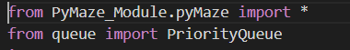
﻿
Used to import all functions classes variables defined in pymaze module within the pymaze module package
importing the PriorityQueue class to manage priorities within the game

Slide 24
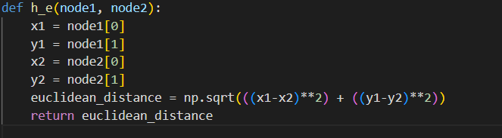
﻿
the first heuristic function calculates the Euclidean distance between two nodes in a maze game and return this distance
the formula of euclidean_distance = sqrt(((x1-x2)**2) + ((y1-y2)**2))

Slide 25
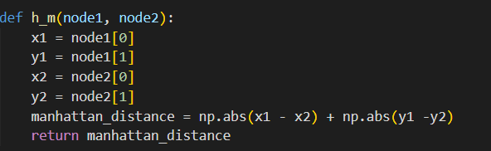
﻿
The second heuristic function calculates the manhattan distance between two nodes in a maze game and return this distance
the formula of the manhattan_distance = |(x1 - x2)| + |(y1 -y2)|

Slide 26
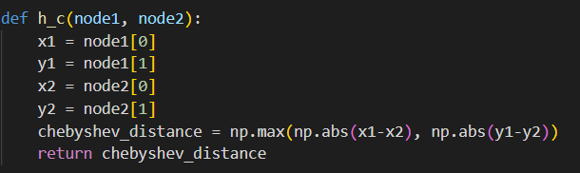
﻿
The third heuristic function calculates the chebyshev distance between two nodes in a maze game and return this distance
the formula of chebyshev_distance =max(y2 - y1, x2 - x1)

Slide 27
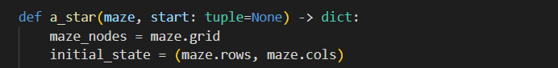
﻿
*maze_nodes = maze.grid: Retrieves the grid of nodes from the maze.
*initial_state = (maze.rows, maze.cols): Initializes the starting state the bottom-right corner of the maze or the last node in the grid.

Slide 28
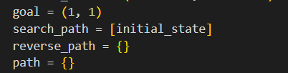
﻿
*goal = (1, 1): Defines the goal state the first node in the grid
*search_path = [initial_state]: Initializes the search path with the starting state.
*reverse_path = {} and path = {}: These dictionaries will be used to reconstruct the optimal path once the A* search is complete.

Slide 29
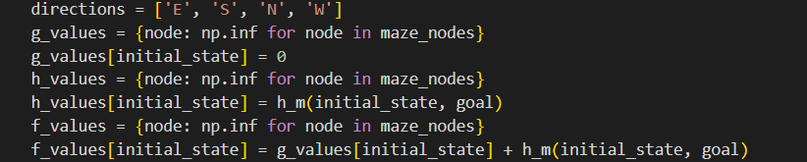
﻿
Defines the directions (East, South, North, West) for movement
*g_values, h_values, and f_values: Dictionaries to store the cost values (g), heuristic values (h), and total cost values (f) for each node in the maze.
*the g values of all nodes are set to be infinity
except the g value inititial state is set to be zero
*the h values for all nodes is set to be infinity except first node it is the manhatten distance to the goal cell
*f valalues for all nodes are set to be infinity
except the initial state equals the sum of the g_values[initial_state}+ the heuristic distance between initial state and the goal

Slide 30
﻿
initiate a priority queue and put in it the
f_values[initial_state , h_values [initial_state] and the initial state itself

Slide 31
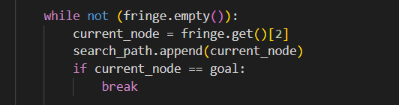
﻿
in this part of code the while loop continues iterating through nodes in the priority queue until either the goal is reached or the priority queue is empty.
The search_path list keeps track of the nodes visited during the search. If the goal is reached, the loop is terminated using break

Slide 32
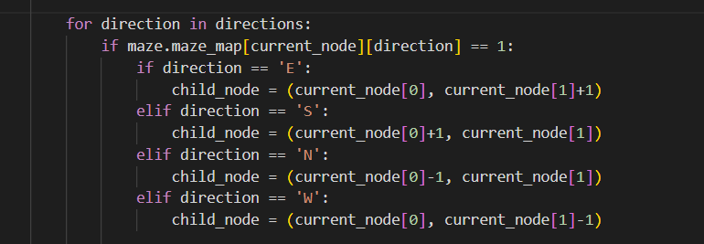
﻿
This block of code essentially explores each valid neighboring node in the specified directions, and for each valid neighbor,
it calculates the coordinates of the child node.

Slide 33

﻿
new_g_value represents the updated cost-so-far for the child node, and the new_f_value represents the updated total cost,
considering both the cost-so-far and the heuristic estimate. These values are crucial for determining the priority of the child node in the priority queue

Slide 34
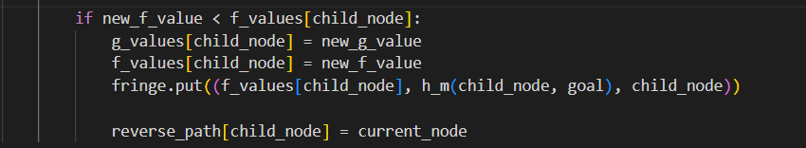
this part of the code is responsible for dynamically updating the cost information for a child node if a more optimal path to that node is discovered during the A* search.
The node is then re-added to the priority queue for exploration , after the algorithm completes the reverse_path information used to trace backward from the goal node to the start node, We will add three values in the priority queue: the f score of the child cell , h score for the child cell and the child cell itself
﻿

Slide 35
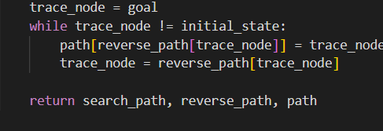
﻿
this part of code first initializes the variable trace_node with the goal node, This is the destination node in the maze ,while loop continues iterating as long as trace_node is not equal to initial_state , which is the starting point in the maze
the job of the while loop is reconstructing the optimal path found by the A* algorithm in a maze

Slide 36
﻿
the code is updating the path dictionary. It assigns the value of trace_node to the key reverse_path[trace_node]
This process is building the path backward from the goal node to the initial state.
After updating the path, the trace_node is set to its predecessor in the reverse path. This is essential for moving backward in the path.
It essentially follows the reverse path from the current node to its predecessor, and this process continues until the loop condition (trace_node != initial_state)
is no longer satisfied.
Once the while loop exits (i.e., trace_node reaches the initial state), the function returns three items:
1:search path :-the path showing how the search was extended
2:reverse path :- is the reverse path from goal to start
3:path:- is the path from start to goal.

Slide 37
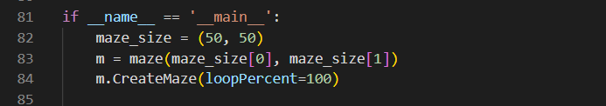
﻿
-if __name__ == '__main__':: This block ensures that the code within it is executed only if the script is run directly
-maze_size = (50, 50): Sets the size of the maze to be 50x50
-m = maze(maze_size[0], maze_size[1]): Creates a maze object with the specified size.
-m.CreateMaze(loopPercent=100): Generates a maze with a loopPercent of 100%, meaning there will be no loops in the maze (perfect maze)

Slide 38
﻿
-seacrhing_path, reverse_path, path = a_star(m): Applies the A* search algorithm to the maze and obtains three paths: the search path, the reverse path (from goal to start), and the shortest path.

Slide 39
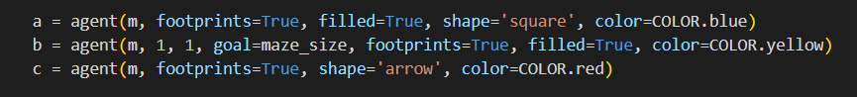
﻿
-Agents Visualization:
a = agent(m, footprints=True, filled=True, shape='square', color=COLOR.blue): Creates an agent for visualizing the search process.
b = agent(m, 1, 1, goal=maze_size, footprints=True, filled=True, color=COLOR.yellow): Creates an agent for visualizing the reverse path from the goal to the start.
c = agent(m, footprints=True, shape='arrow', color=COLOR.red): Creates an agent for visualizing the shortest path.

Slide 40
﻿
search_label and shortest_path_label: Create text labels to display the number of steps in the search and shortest path, respectively.

Slide 41
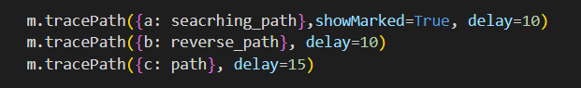
﻿
-Visualization of Paths:
m.tracePath({a: seacrhing_path}, showMarked=True, delay=10): Visualizes the A* search process with the agent a.
m.tracePath({b: reverse_path}, delay=10): Visualizes the reverse path with the agent b.
m.tracePath({c: path}, delay=15): Visualizes the shortest path with the agent c.

Slide 42
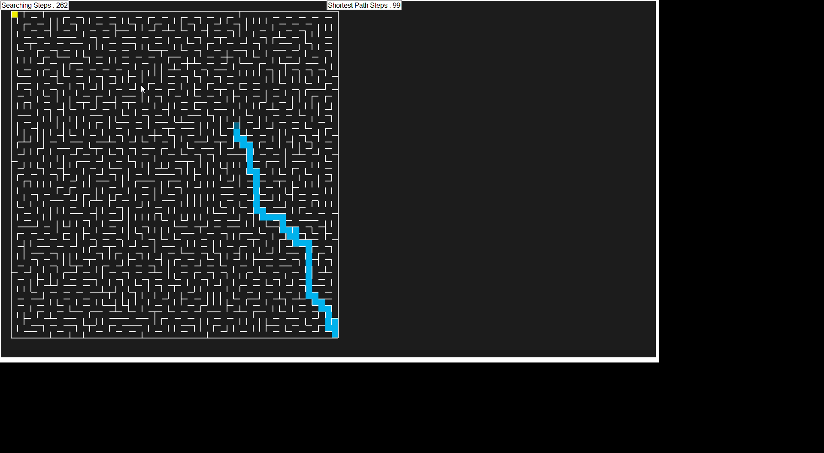
Video shows maze in A*

Slide 43
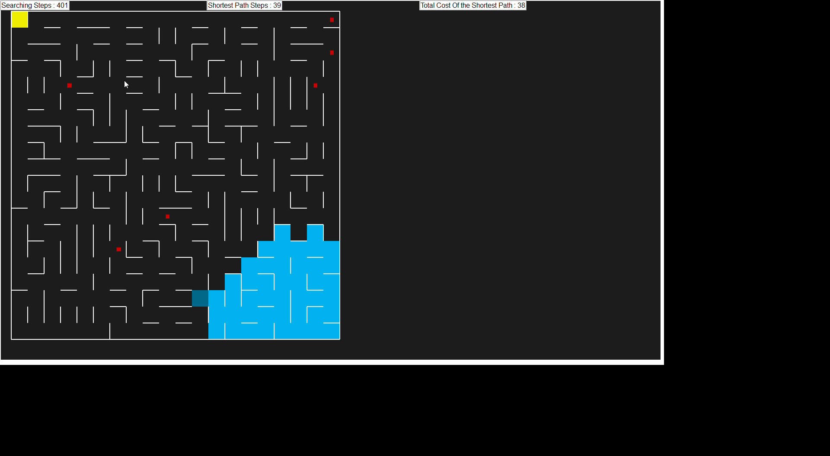
Video shows maze in Dijkstra

Slide 44
﻿THANK YOU

